Slide 1
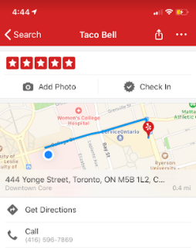
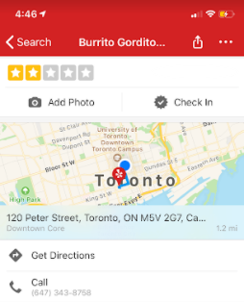
Taco Bell
- “Nice atmosphere”
Authentic Mexican
- “Too spicy”

Slide 2



Rating Application
User Data
Consumer

Slide 3
Rating Application
Consumer
User Data

Slide 4

Rating Application
Consumer
User Data

Slide 5

Rating Application
Consumer
User Data

Slide 6
